Slide 1
Chapter 23 - Exception Handling
Outline
23.1 Introduction
23.2 When Exception Handling Should Be Used
23.3 Other Error-Handling Techniques
23.4 Basics of C++ Exception Handling: try, throw, catch
23.5 A Simple Exception-Handling Example: Divide by Zero
23.6 Throwing an Exception
23.7 Catching an Exception
23.8 Rethrowing an Exception
23.9 Exception Specifications
23.10 Processing Unexpected Exceptions
23.11 Stack Unwinding
23.12 Constructors, Destructors and Exception Handling
23.13 Exceptions and Inheritance
23.14 Processing new Failures
23.15 Class auto_ptr and Dynamic Memory Allocation
23.16 Standard Library Exception Hierarchy

Slide 2
Objectives
In this chapter, you will learn:
  To use try, throw and catch to watch for, indicate and handle exceptions, respectively.
  To process uncaught and unexpected exceptions.
  To be able to process new failures.
  To use auto_ptr to prevent memory leaks.
  To understand the standard exception hierarchy.

Slide 3
23.1 Introduction
Errors can be dealt with at place error occurs
  Easy to see if proper error checking implemented
  Harder to read application itself and see how code works
Exception handling
  Makes clear, robust, fault-tolerant programs
  C++ removes error handling code from "main line" of program
Common failures
  new not allocating memory
  Out of bounds array subscript
  Division by zero
  Invalid function parameters

Slide 4
23.1 Introduction (II)
Exception handling - catch errors before they occur
  Deals with synchronous errors (i.e., Divide by zero)
  Does not deal with asynchronous errors - disk I/O completions, mouse clicks - use interrupt processing
  Used when system can recover from error
    Exception handler - recovery procedure
  Typically used when error dealt with in different place than where it occurred
  Useful when program cannot recover but must shut down cleanly
Exception handling should not be used for program control
  Not optimized, can harm program performance

Slide 5
23.1 Introduction (III)
Exception handling improves fault-tolerance
  Easier to write error-processing code
  Specify what type of exceptions are to be caught
Most programs support only single threads
  Techniques in this chapter apply for multithreaded OS as well (windows NT, OS/2, some UNIX)
Exception handling another way to return control from a function or block of code

Slide 6
23.2 When Exception Handling Should Be Used
Error handling should be used for
  Processing exceptional situations
  Processing exceptions for components that cannot handle them directly
  Processing exceptions for widely used components (libraries, classes, functions) that should not process their own exceptions
  Large projects that require uniform error processing

Slide 7
23.3 Other Error-Handling Techniques
Use assert
  If assertion false, the program terminates
Ignore exceptions
  Use this "technique" on casual, personal programs - not commercial!
Abort the program
  Appropriate for nonfatal errors give appearance that program functioned correctly
  Inappropriate for mission-critical programs, can cause resource leaks
Set some error indicator
  Program may not check indicator at all points where error could occur

Slide 8
23.3 Other Error-Handling Techniques (II)
Test for the error condition
  Issue an error message and call exit
  Pass error code to environment
setjump and longjump
  In <csetjmp>
  Jump out of deeply nested function calls back to an error handler.
  Dangerous - unwinds the stack without calling destructors for automatic objects (more later)
Specific errors
  Some have dedicated capabilities for handling them
  If new fails to allocate memory new_handler function executes to deal with problem

Slide 9
23.4 Basics of C++ Exception Handling: try, throw, catch
A function can throw an exception object if it detects an error
  Object typically a character string (error message) or class object
  If exception handler exists, exception caught and handled
  Otherwise, program terminates

Slide 10
23.4 Basics of C++ Exception Handling: try, throw, catch (II)
Format
  Enclose code that may have an error in try block
  Follow with one or more catch blocks
    Each catch block has an exception handler
  If exception occurs and matches parameter in catch block, code in catch block executed
  If no exception thrown, exception handlers skipped and control resumes after catch blocks
  throw point - place where exception occurred
    Control cannot return to throw point

Slide 11
23.5 A Simple Exception-Handling Example: Divide by Zero
Look at the format of try and catch blocks
Afterwards, we will cover specifics

Slide 12
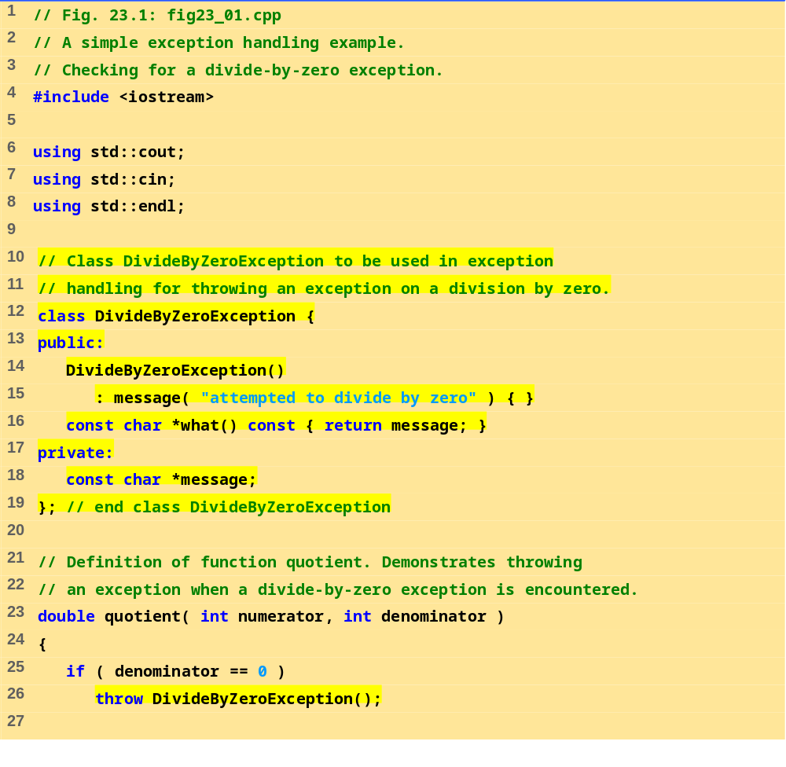
fig23_01.cpp (Part 1 of 3)

Slide 13
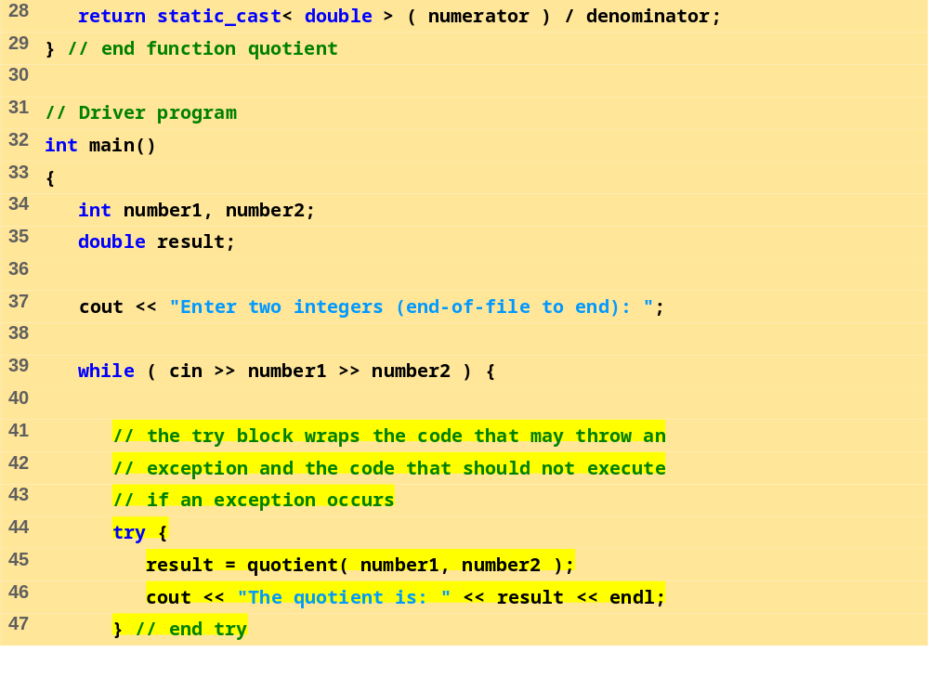
fig23_01.cpp (Part 2 of 3)

Slide 14
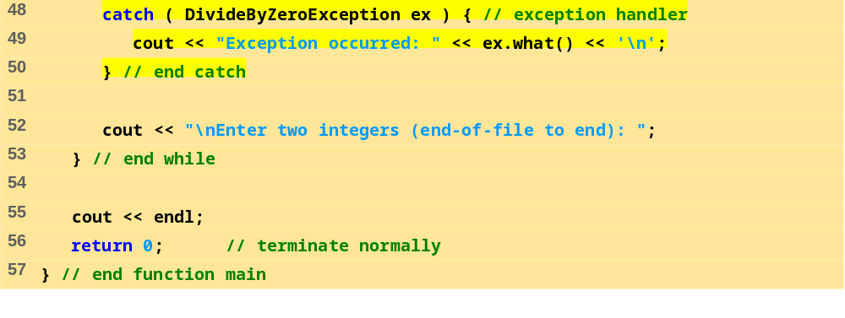
fig23_01.cpp (Part 3 of 3)
Program Output
Enter two integers (end-of-file to end): 100 7
The quotient is: 14.2857
Enter two integers (end-of-file to end): 100 0
Exception occurred: attempted to divide by zero
Enter two integers (end-of-file to end): 33 9
The quotient is: 3.66667
Enter two integers (end-of-file to end):^Z

Slide 15
23.6 Throwing an Exception
throw - indicates an exception has occurred
  Usually has one operand (sometimes zero) of any type
    If operand an object, called an exception object
    Conditional expression can be thrown
  Code referenced in a try block can throw an exception
  Exception caught by closest exception handler
  Control exits current try block and goes to catch handler (if it exists)
  Example (inside function definition)
  if ( denominator == 0 )
  throw DivideByZeroException();
    Throws a dividebyzeroexception object

Slide 16
23.6 Throwing an Exception (II)
Exception not required to terminate program
  However, terminates block where exception occurred

Slide 17
23.7 Catching an Exception
Exception handlers are in catch blocks
  Format: catch( exceptionType parameterName){
    exception handling code
    }
  Caught if argument type matches throw type
  If not caught then terminate called which (by default) calls abort
  Example:
  catch ( DivideByZeroException ex) {
  cout << "Exception occurred: " << ex.what() <<'\n'
  }
    Catches exceptions of type DivideByZeroException

Slide 18
23.7 Catching an Exception (II)
Catch all exceptions
  catch(...) - catches all exceptions
    You do not know what type of exception occurred
    There is no parameter name - cannot reference the object
If no handler matches thrown object
  Searches next enclosing try block
    If none found, terminate called
  If found, control resumes after last catch block
  If several handlers match thrown object, first one found is executed

Slide 19
23.7 Catching an Exception (III)
catch parameter matches thrown object when
  They are of the same type
    Exact match required - no promotions/conversions allowed
  The catch parameter is a public base class of the thrown object
  The catch parameter is a base-class pointer/ reference type and the thrown object is a derived-class pointer/ reference type
  The catch handler is catch( ... )
  Thrown const objects have const in the parameter type

Slide 20
23.7 Catching an Exception (IV)
Unreleased resources
  Resources may have been allocated when exception thrown
  catch handler should delete space allocated by new and close any opened files
catch handlers can throw exceptions
  Exceptions can only be processed by outer try blocks

Slide 21
23.8 Rethrowing an Exception
Rethrowing exceptions
  Used when an exception handler cannot process an exception
  Rethrow exception with the statement:
    throw;
    No arguments
    If no exception thrown in first place, calls terminate
  Handler can always rethrow exception, even if it performed some processing
  Rethrown exception detected by next enclosing try block

Slide 22
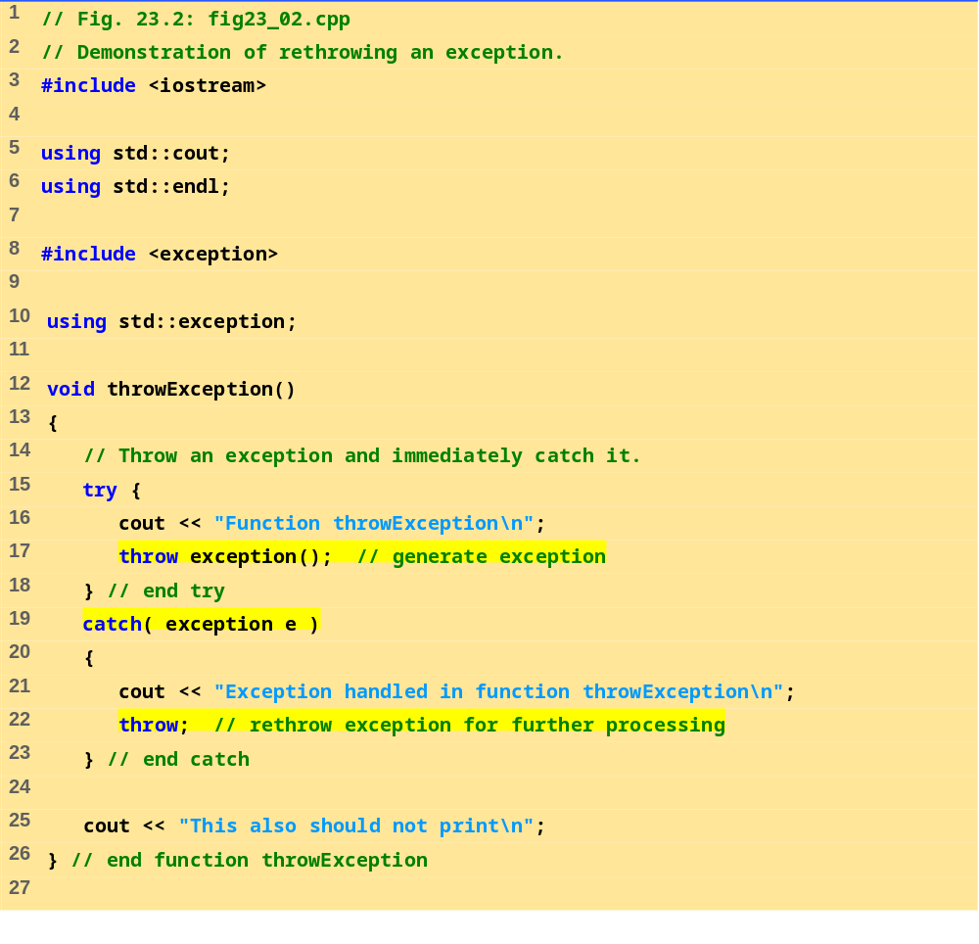
fig23_02.cpp (Part 1 of 2)

Slide 23
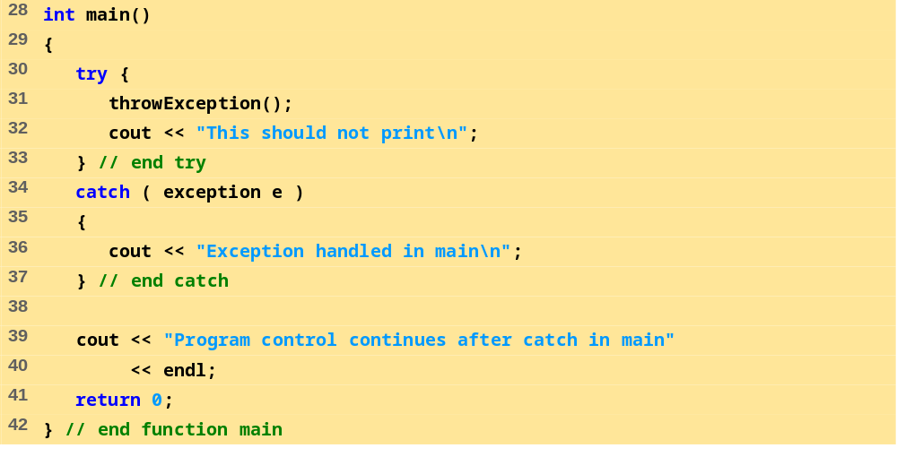
fig23_02.cpp (Part 2 of 2)
Program Output
Function throwException
Exception handled in function throwException
Exception handled in main
Program control continues after catch in main

Slide 24
23.9 Exception Specifications
Exception specification (throw list)
  Lists exceptions that can be thrown by a function
Example:
  int g( double h ) throw ( a, b, c )
  {
  // function body
  }
  Function can throw listed exceptions or derived types
  If other type thrown, function unexpected called
  throw() (i.e., no throw list) states that function will not throw any exceptions
    In reality, function can still throw exceptions, but calls unexpected (more later)
  If no throw list specified, function can throw any exception

Slide 25
23.10 Processing Unexpected Exceptions
Function unexpected
  Calls the function specified with set_unexpected
    Default: terminate
Function terminate
  Calls function specified with set_terminate
    Default: abort
set_terminate and set_unexpected
  Prototypes in <exception>
  Take pointers to functions (i.e., Function name)
    Function must return void and take no arguments
  Returns pointer to last function called by terminate or unexpected

Slide 26
23.11 Stack Unwinding
Function-call stack unwound when exception thrown and not caught in a particular scope
  Tries to catch exception in next outer try/catch block
  Function in which exception was not caught terminates
    Local variables destroyed
    Control returns to place where function was called
  If control returns to a try block, attempt made to catch exception
    Otherwise, further unwinds stack
  If exception not caught, terminate called

Slide 27
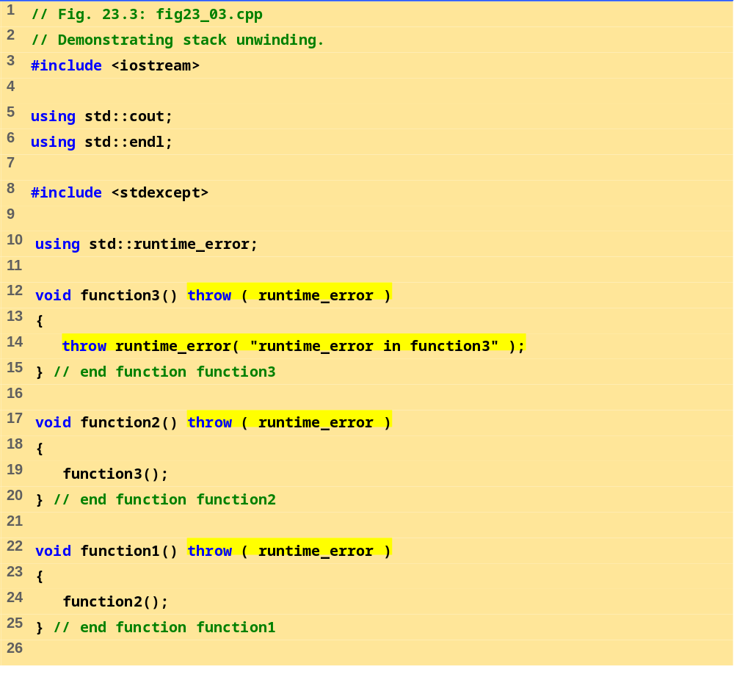
fig23_03.cpp (Part 1 of 2)

Slide 28
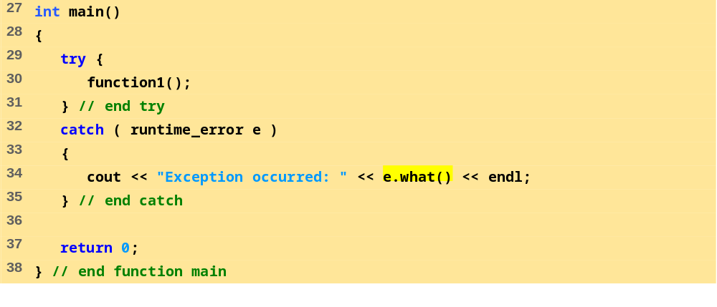
fig23_03.cpp (Part 2 of 2)
Program Output
Exception occurred: runtime_error in function3

Slide 29
23.12 Constructors, Destructors and Exception Handling
What to do with an error in a constructor?
  A constructor cannot return a value - how do we let the outside world know of an error?
    Keep defective object and hope someone tests it
    Set some variable outside constructor
  A thrown exception can tell outside world about a failed constructor
  catch handler must have a copy constructor for thrown object

Slide 30
23.12 Constructors, Destructors and Exception Handling (II)
Thrown exceptions in constructors
  Destructors called for all completed base-class objects and member objects before exception thrown
  If the destructor that is originally called due to stack unwinding ends up throwing an exception, terminate called
  If object has partially completed member objects when exception thrown, destructors called for completed objects

Slide 31
23.12 Constructors, Destructors and Exception Handling (II)
Resource leak
  Exception comes before code that releases a resource
  One solution: initialize local object when resource acquired
    Destructor will be called before exception occurs
catch exceptions from destructors
  Enclose code that calls them in try block followed by appropriate catch block

Slide 32
23.13 Exceptions and Inheritance
Exception classes can be derived from base classes
If catch can get a pointer/reference to a base class, can also catch pointers/references to derived classes

Slide 33
23.14 Processing new Failures
If new could not allocate memory
  Old method - use assert function
    If new returns 0, abort
    Does not allow program to recover
  Modern method (header <new>)
    new throws bad_alloc exception
  Method used depends on compiler
  On some compilers: use new(nothrow) instead of new to have new return 0 when it fails
    Function set_new_handler(functionName) - sets which function is called when new fails.
    Function can return no value and take no arguments
    new will not throw bad_alloc

Slide 34
23.14 Processing new Failures (II)
new
  Loop that tries to acquire memory
A new handler function should either:
  Make more memory available by deleting other dynamically allocated memory and return to the loop in operator new
  Throw an exception of type bad_alloc
  Call function abort or exit (header <cstdlib>) to terminate the program

Slide 35
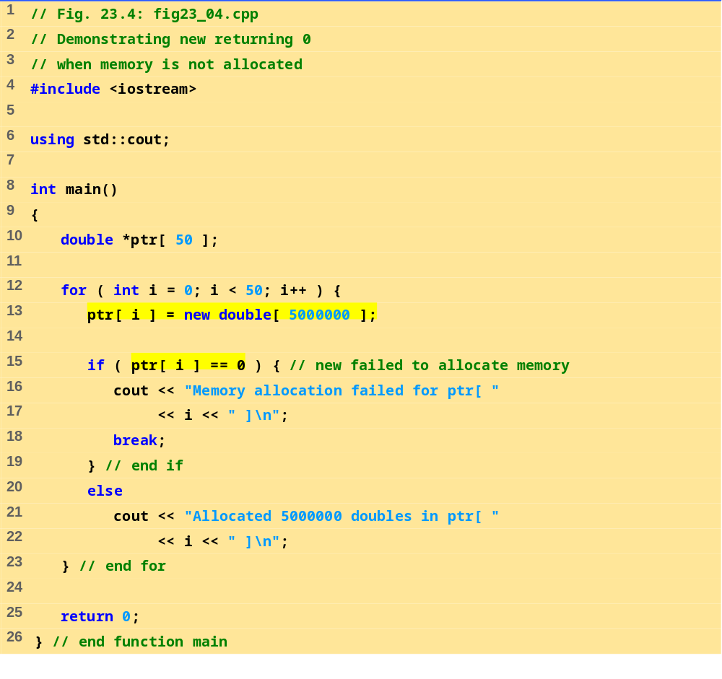
fig23_04.cpp

Slide 36
Allocated 5000000 doubles in ptr[ 0 ]
Allocated 5000000 doubles in ptr[ 1 ]
Allocated 5000000 doubles in ptr[ 2 ]
Allocated 5000000 doubles in ptr[ 3 ]
Memory allocation failed for ptr[ 4 ]
Program Output

Slide 37
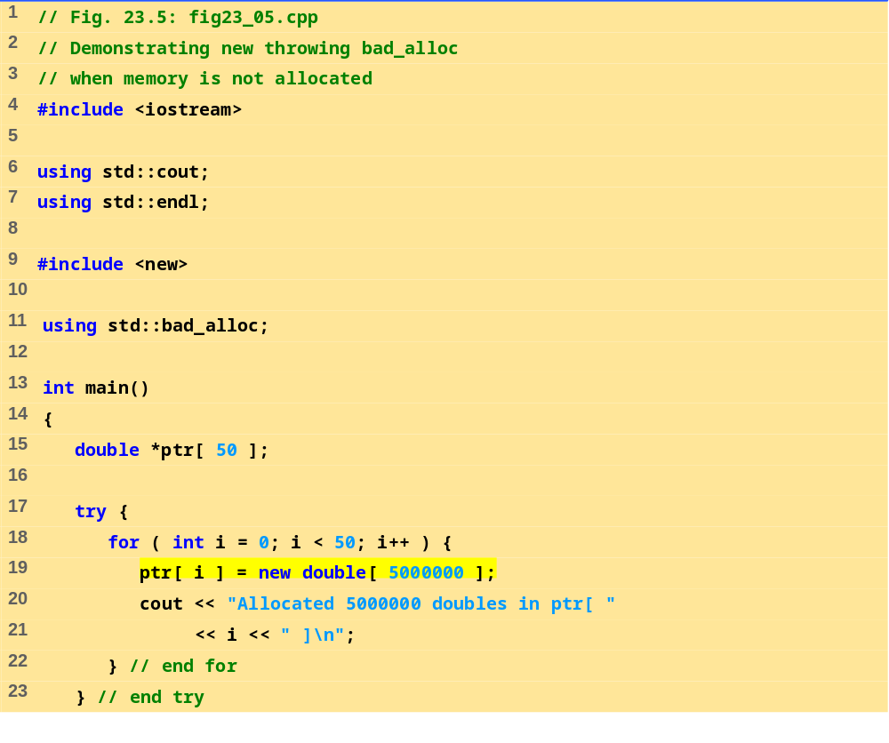
fig23_05.cpp (Part 1 of 2)

Slide 38
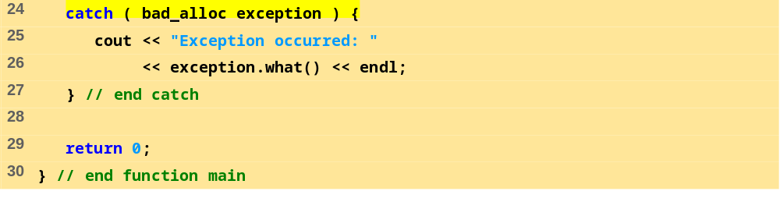
fig23_05.cpp (Part 2 of 2)
Program Output
Allocated 5000000 doubles in ptr[ 0 ]
Allocated 5000000 doubles in ptr[ 1 ]
Allocated 5000000 doubles in ptr[ 2 ]
Allocated 5000000 doubles in ptr[ 3 ]
Exception occurred: Allocation Failure

Slide 39
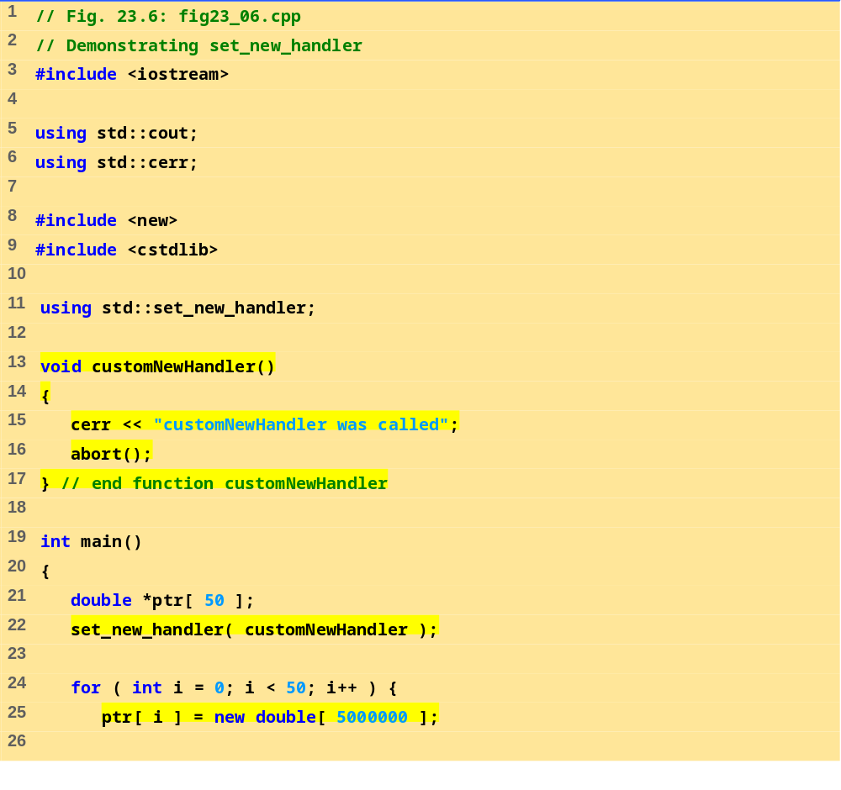
fig23_06.cpp (Part 1 of 2)

Slide 40
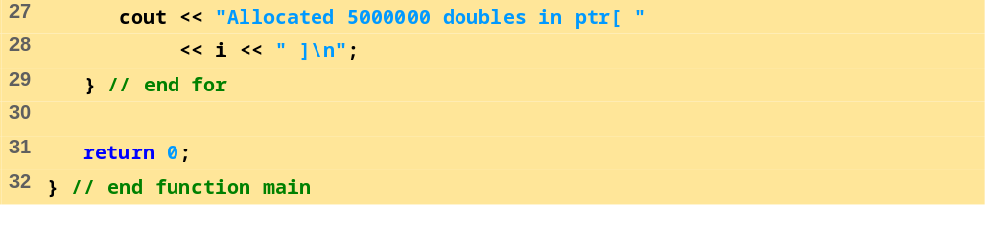
fig23_06.cpp (Part 2 of 2)
Program Output
Allocated 5000000 doubles in ptr[ 0 ]
Allocated 5000000 doubles in ptr[ 1 ]
Allocated 5000000 doubles in ptr[ 2 ]
Allocated 5000000 doubles in ptr[ 3 ]
customNewHandler was called

Slide 41
23.15 Class auto_ptr and Dynamic Memory Allocation
Pointers to dynamic memory
  Memory leak can occur if exceptions happens before delete command
  Use class template auto_ptr (header <memory> ) to resolve this
  auto_ptr objects act just like pointers
    Automatically deletes what it points to when it is destroyed (leaves scope)
    Can use * and -> like normal pointers

Slide 42
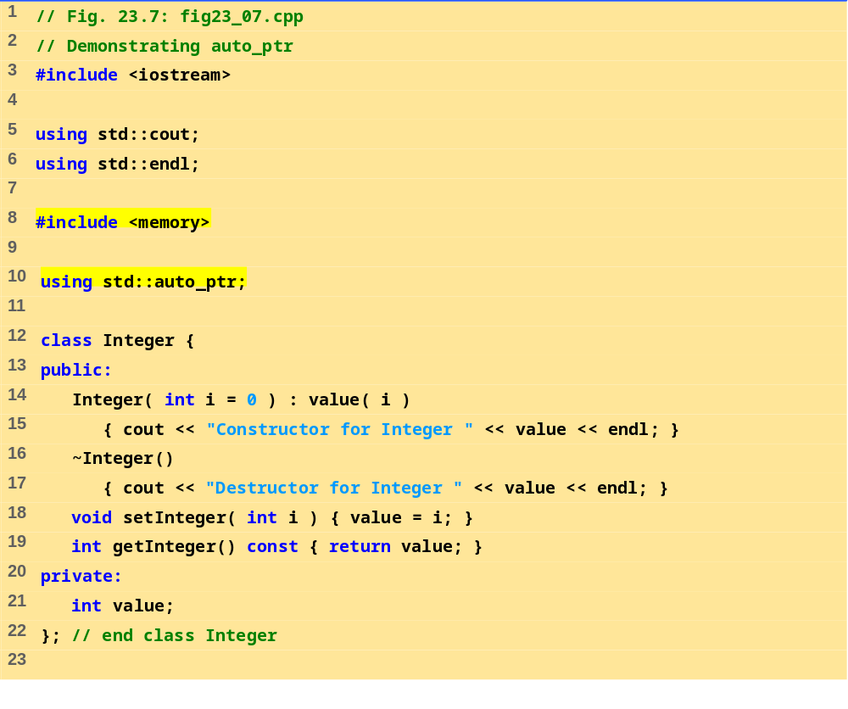
fig23_07.cpp (Part 1 of 2)

Slide 43
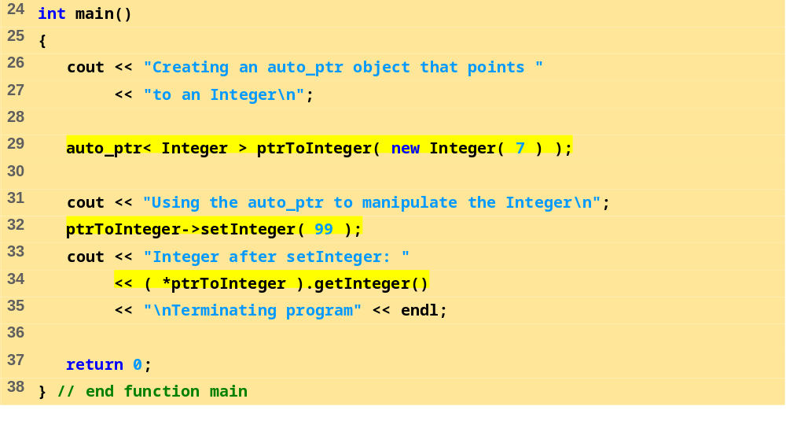
fig23_07.cpp (Part 2 of 2)
Program Output
Creating an auto_ptr object that points to an Integer
Constructor for Integer 7
Using the auto_ptr to manipulate the Integer
Integer after setInteger: 99
Terminating program
Destructor for Integer 99

Slide 44
23.16 Standard Library Exception Hierarchy
Exceptions fall into categories
  Hierarchy of exception classes
  Base class exception (header <exception>)
    Function what() issues appropriate error message
  Derived classes: runtime_error and logic_error (header <stdexcept>)
Class logic_error
  Errors in program logic, can be prevented by writing proper code
  Derived classes:
    invalid_argument - invalid argument passed to function
    length_error - length larger than maximum size allowed was used
    out_of_range - out of range subscript

Slide 45
23.16 Standard Library Exception Hierarchy (II)
Class runtime_error
  Errors detected at execution time
  Derived classes:
    overflow_error - arithmetic overflow
    underflow_error - arithmetic underflow
Other classes derived from exception
  Exceptions thrown by C++ language features
    new - bad_alloc
    dynamic_cast - bad_cast
    typeid - bad_typeid
  Put std::bad_exception in throw list
    unexpected() will throw bad_exception instead of calling function set by set_unexpected

